Slide 1
Chapter 3 – Sequential Logic
Digital Design and Computer Architecture, 2nd Edition
David Money Harris and Sarah L. Harris

Slide 2
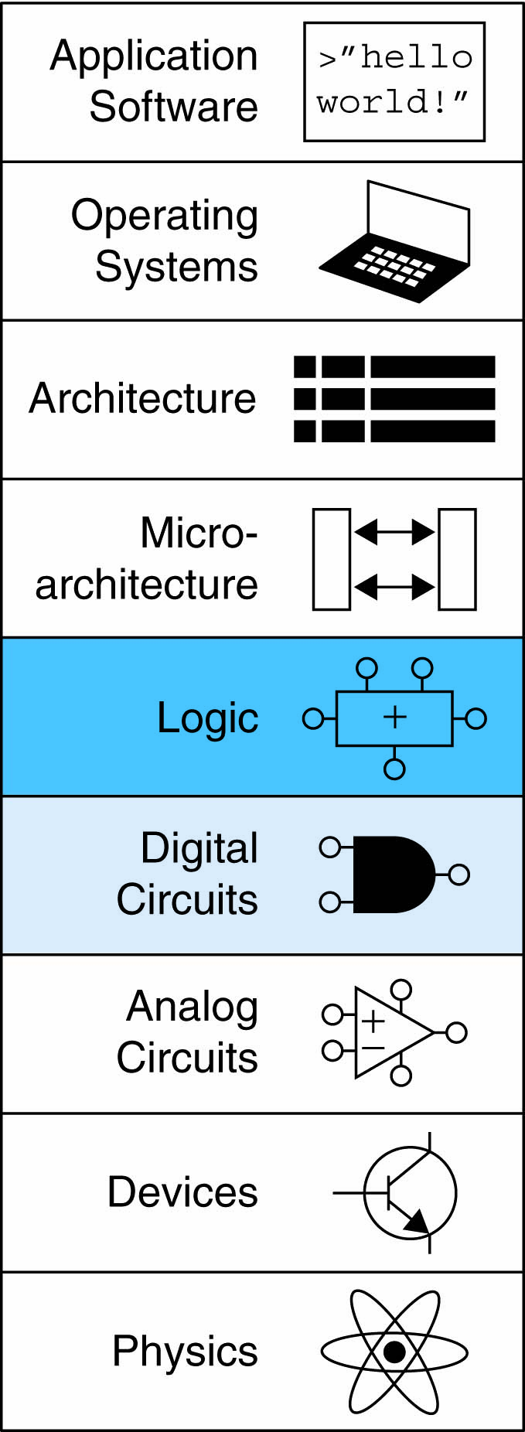
Chapter 3 :: Topics
Finite State Machines

Slide 3
Sequential Circuits
Sequential circuits are used anytime that we have a “stateful” application.
A stateful application is one where the next state of the machine depends on the current state of the machine and the input.
A stateful application requires both combinational and sequential logic.

Slide 4
Finite State Machines
The behaviour of sequential circuits can be expressed using finite state machines (FSMs).
An FSM:
Takes an input and a current state.
Produces an output and a new state.
It is called a Finite State Machine because it can have, at most, a finite number of states.
It is composed of combinational logic components and flip-flops placed in such a way as to maintain state information.

Slide 5
Finite State Machines
FSMs can be represented by a set of nodes that hold the states of the machine and a set of arcs that connect the states.
A circle with the state name in it for each state.
A directed arc from the Present State to the Next State for each state transition.
A label on each directed arc with the input values which causes the state transition.
A label:
On each circle with the output value produced, or
On each directed arc with the output value produced.
D=1
D=1
Q=0
Q=1
D=0
D=1
Notes:
The state diagram shown is that for a D flip-flop.
BUT note that the diagram does not indicate *when* the transitions take place. For a D flip-flop it is of course on the clock rising edge.

Slide 6
Finite State Machines
Moore and Mealy machines are two types of FSMs that are equivalent.
They differ only in how they express the outputs of the machine.
Moore FSM: outputs depend only on current state
Mealy FSM: outputs depend on current state and inputs

Slide 7
Finite State Machines
Consist of:
State register
Stores current state
Loads next state at clock edge
Combinational logic
Computes the next state
Consist of:
State register
Stores current state
Loads next state at clock edge
Combinational logic
Computes the outputs

Slide 8
FSM Example
Traffic light controller
Traffic sensors: T_{A}, T_{B} (TRUE when there’s traffic)
Lights: L_{A}, L_{B}

Slide 9
FSM Black Box
Inputs: CLK, Reset, T_{A}, T_{B}
Outputs: L_{A}, L_{B}

Slide 10
FSM State Transition Diagram
Moore FSM: outputs labeled in each state
States: Circles
Transitions: Arcs

Slide 11
FSM State Transition Diagram
Moore FSM: outputs labeled in each state
States: Circles
Transitions: Arcs

Slide 12
FSM State Transition Table
Current State | Inputs |  | Next State
S | T_{A} | T_{B} | S'
S0 | 0 | X
S0 | 1 | X
S1 | X | X
S2 | X | 0
S2 | X | 1
S3 | X | X

Slide 13
FSM State Transition Table
Current State | Inputs |  | Next State
S | T_{A} | T_{B} | S'
S0 | 0 | X | S1
S0 | 1 | X | S0
S1 | X | X | S2
S2 | X | 0 | S3
S2 | X | 1 | S2
S3 | X | X | S0

Slide 14
FSM Encoded State Transition Table
Current State |  | Inputs |  | Next State
S₁ | S₀ | T_{A} | T_{B} | S'₁ | S'₀
0 | 0 | 0 | X
0 | 0 | 1 | X
0 | 1 | X | X
1 | 0 | X | 0
1 | 0 | X | 1
1 | 1 | X | X
State | Encoding
S0 | 00
S1 | 01
S2 | 10
S3 | 11

Slide 15
FSM Encoded State Transition Table
Current State |  | Inputs |  | Next State
S₁ | S₀ | T_{A} | T_{B} | S'₁ | S'₀
0 | 0 | 0 | X | 0 | 1
0 | 0 | 1 | X | 0 | 0
0 | 1 | X | X | 1 | 0
1 | 0 | X | 0 | 1 | 1
1 | 0 | X | 1 | 1 | 0
1 | 1 | X | X | 0 | 0
State | Encoding
S0 | 00
S1 | 01
S2 | 10
S3 | 11
S'₁ = S₁ ⊕ S₀
S'₀ = S₁S₀T_{A} + S₁S₀T_{B}

Slide 16
FSM Output Table
Current State |  | Outputs
S₁ | S₀ | L_{A1} | L_{A0} | L_{B1} | L_{B0}
0 | 0
0 | 1
1 | 0
1 | 1
Output | Encoding
green | 00
yellow | 01
red | 10

Slide 17
FSM Output Table
Current State |  | Outputs
S₁ | S₀ | L_{A1} | L_{A0} | L_{B1} | L_{B0}
0 | 0 | 0 | 0 | 1 | 0
0 | 1 | 0 | 1 | 1 | 0
1 | 0 | 1 | 0 | 0 | 0
1 | 1 | 1 | 0 | 0 | 1
Output | Encoding
green | 00
yellow | 01
red | 10
L_{A1} = S₁
L_{A0} = S₁S₀
L_{B1} = S₁
L_{B0} = S₁S₀

Slide 18
FSM Schematic: State Register

Slide 19
FSM Schematic: Next State Logic

Slide 20
FSM Schematic: Output Logic

Slide 21
FSM Timing Diagram

Slide 22
FSM State Encoding
Binary encoding:
i.e., for four states, 00, 01, 10, 11
One-hot encoding
One state bit per state
Only one state bit HIGH at once
i.e., for 4 states, 0001, 0010, 0100, 1000
Requires more flip-flops
Often next state and output logic is simpler

Slide 23
FSM Example: Paper Tape
A snail that crawls down a paper tape with 1’s and 0’s on it. The snail smiles whenever the last two digits it has crawled over are 01.
How do we design Moore and Mealy FSMs of the snail’s brain?
Let’s begin with the Moore version …

Slide 24
State Transition Diagrams
Mealy FSM: arcs indicate input/output

Slide 25
Moore FSM State Transition Table
Current State |  | Inputs | Next State
S₁ | S₀ | A | S'₁ | S'₀
0 | 0 | 0
0 | 0 | 1
0 | 1 | 0
0 | 1 | 1
1 | 0 | 0
1 | 0 | 1
State | Encoding
S0 | 00
S1 | 01
S2 | 10

Slide 26
Moore FSM State Transition Table
Current State |  | Inputs | Next State
S₁ | S₀ | A | S'₁ | S'₀
0 | 0 | 0 | 0 | 1
0 | 0 | 1 | 0 | 0
0 | 1 | 0 | 0 | 1
0 | 1 | 1 | 1 | 0
1 | 0 | 0 | 0 | 1
1 | 0 | 1 | 0 | 0
State | Encoding
S0 | 00
S1 | 01
S2 | 10
S₁’ = S₀A
S₀’ = A

Slide 27
Moore FSM Output Table
Current State |  | Output
S₁ | S₀ | Y
0 | 0
0 | 1
1 | 0
Y = S₁

Slide 28
Moore FSM Output Table
Current State |  | Output
S₁ | S₀ | Y
0 | 0 | 0
0 | 1 | 0
1 | 0 | 1
Y = S₁

Slide 29
Mealy FSM State Transition & Output Table
Current State | Input | Next State | Output
S₀ | A | S'₀ | Y
0 | 0
0 | 1
1 | 0
1 | 1
State | Encoding
S0 | 00
S1 | 01

Slide 30
Mealy FSM State Transition & Output Table
Current State | Input | Next State | Output
S₀ | A | S'₀ | Y
0 | 0 | 1 | 0
0 | 1 | 0 | 0
1 | 0 | 1 | 0
1 | 1 | 0 | 1
State | Encoding
S0 | 00
S1 | 01

Slide 31
Moore FSM Schematic

Slide 32
Mealy FSM Schematic

Slide 33
Moore & Mealy Timing Diagram

Slide 34
FSM Design Procedure
Identify inputs and outputs
Sketch state transition diagram
Write state transition table
Select state encodings
For Moore machine:
Rewrite state transition table with state encodings
Write output table
For a Mealy machine:
Rewrite combined state transition and output table with state encodings
Write Boolean equations for next state and output logic
Sketch the circuit schematic

